Slide 1


AUTOMATED
INTERVIEW PROCESSING SYSTEM
24-25J-047

Slide 2
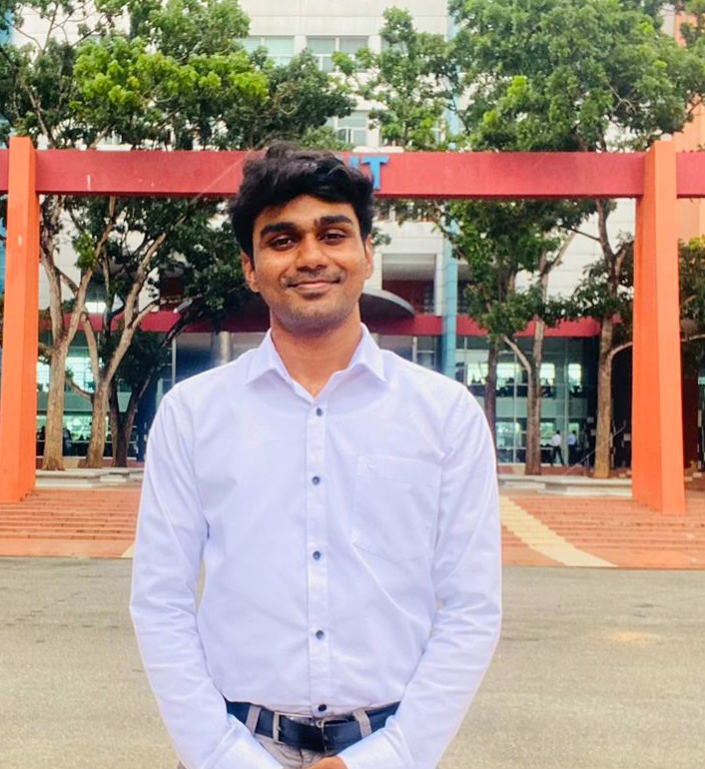
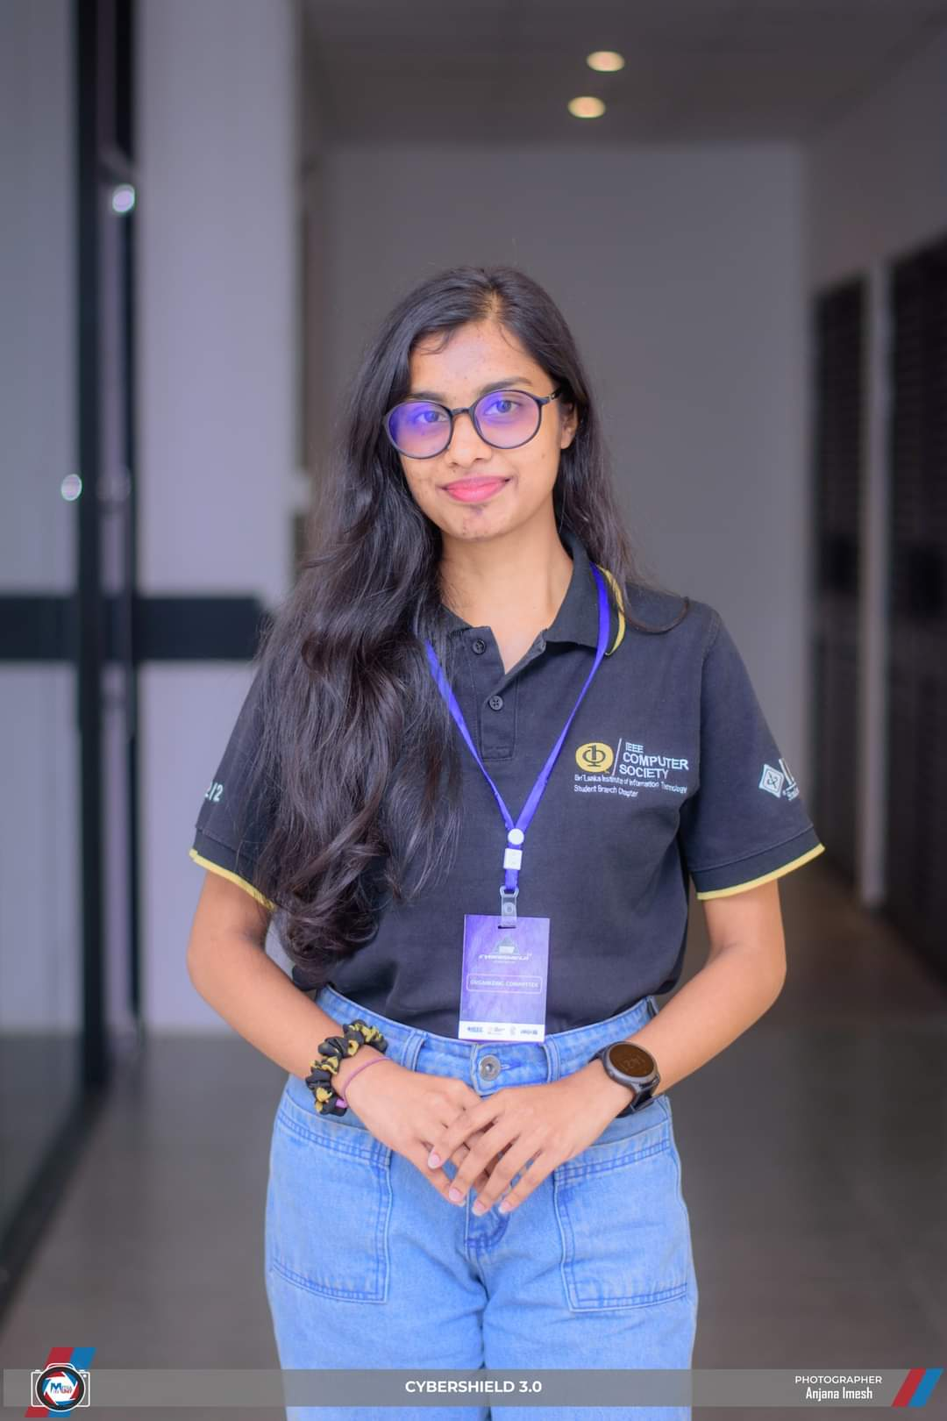
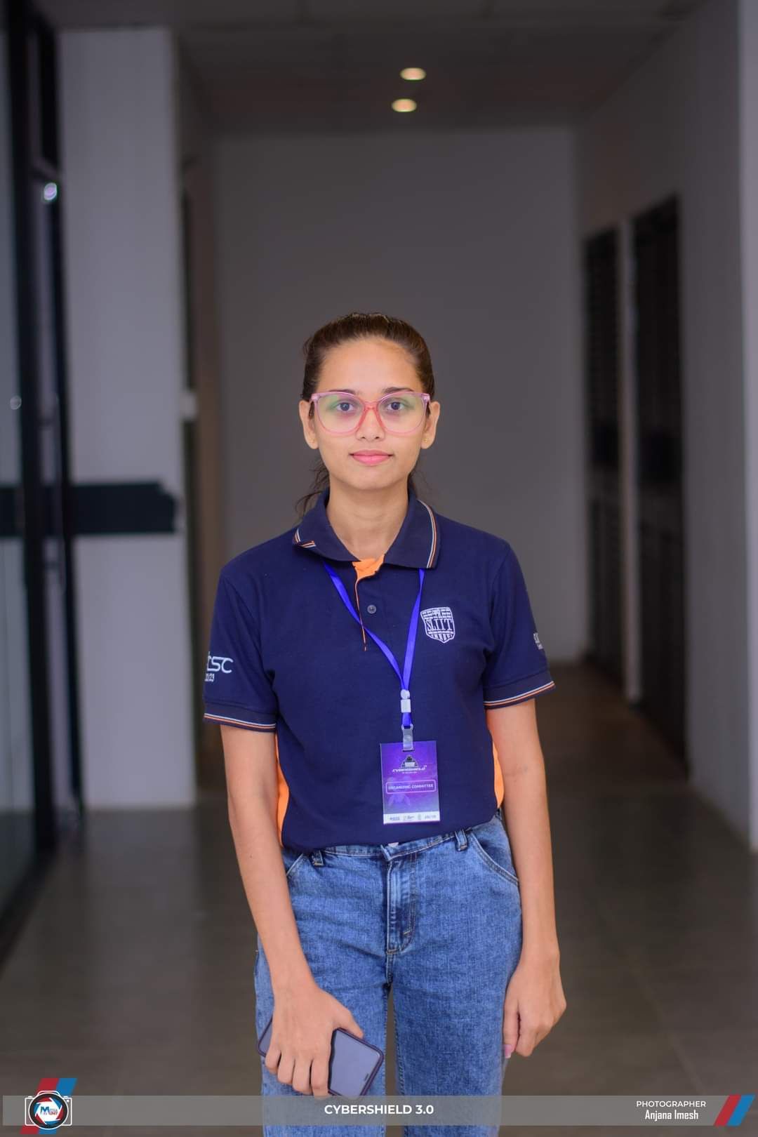

Team
Gunarathna N.W.P.B.M
Thennakoon T.M.I.C
Anjalie P.M.R.S
Pinsara A.R.D
IT21319792
IT21170966
IT21167232
IT 21158186
Marketing Head

Slide 3

INTRODUCTION
Traditional interview methods often fail to capture the complete picture of a candidate's capabilities and personality.

Slide 4

RESEARCH PROBLEM
Current interview processes are often subjective and limited in scope, failing to provide a holistic assessment of candidates.
There is a need for an automated tool that integrates multiple evaluation techniques to offer a comprehensive and objective analysis of candidates' capabilities and suitability for roles.

Slide 5
Team
Pinsara A.R.D
VIDEO BASED MOCKUP EXAM
IT 21158186
Thennakoon T.M.I.C
ASSESS STRESS IN GAMIFIED ENVIRONMENT
IT 21170966
Anjalie P.M.R.S
ASSESS CODE COMPLEXITY AND MAINTAINABILITY
IT 21167232
Gunarathna N.W.P.B.M
ASSESS CONFIDENCE LEVEL FROM VOICE FREQUENCY
Marketing Head
IT 21319792

Slide 6


RESEARCH OBJECTIVES
To develop an automated interview process tool that provides a comprehensive and objective assessment of candidates by evaluating personality traits, technical skills, problem-solving abilities, code complexity, maintainability, and non-verbal communication aspects.
To create algorithms that assess personality traits and confidence levels from vocal features.
Integrate emotional analysis and gamified assessments for evaluate technical skills.
Assesses the complexity and maintainability of code submissions.
create video-based mockup tests and cover letters to evaluate candidates’ Background suitability to the company.
Validate the effectiveness of the integrated tool against traditional assessment methods and industry benchmarks.

Slide 7

WHAT THIS SYSTEM WILL EVALUATE
PERSONALITY TRAITS
TECHNICAL SKILLS,
PROBLEM-SOLVING ABILITIES
CODE COMPLEXITY & MAINTAINABILITY
STRESS LEVEL
CONFIDENCE LEVELS
During Interview Process

Slide 8
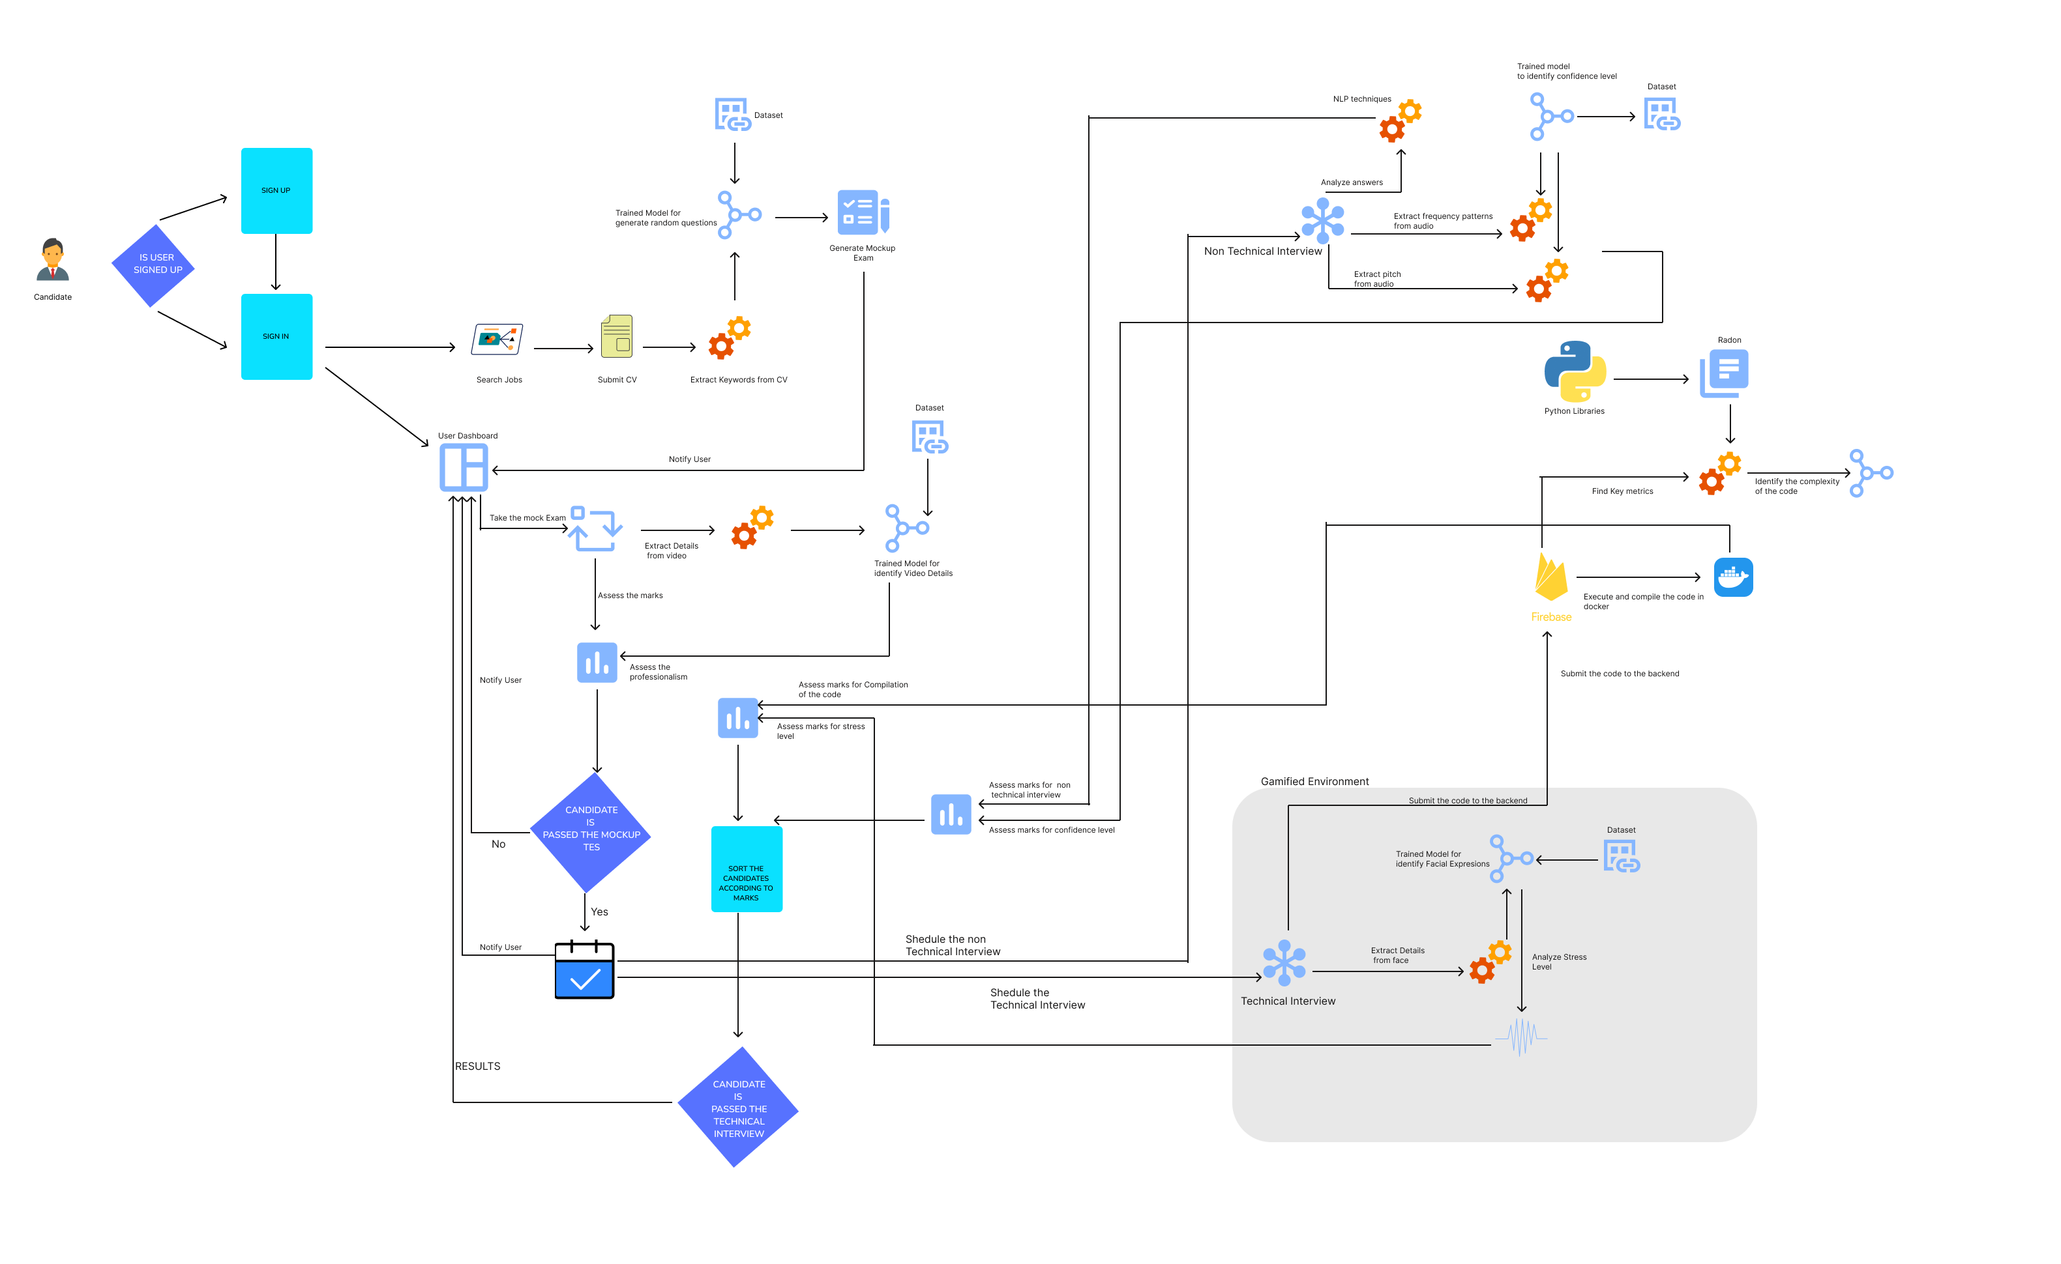
OVERALL SOLUTION

Slide 9
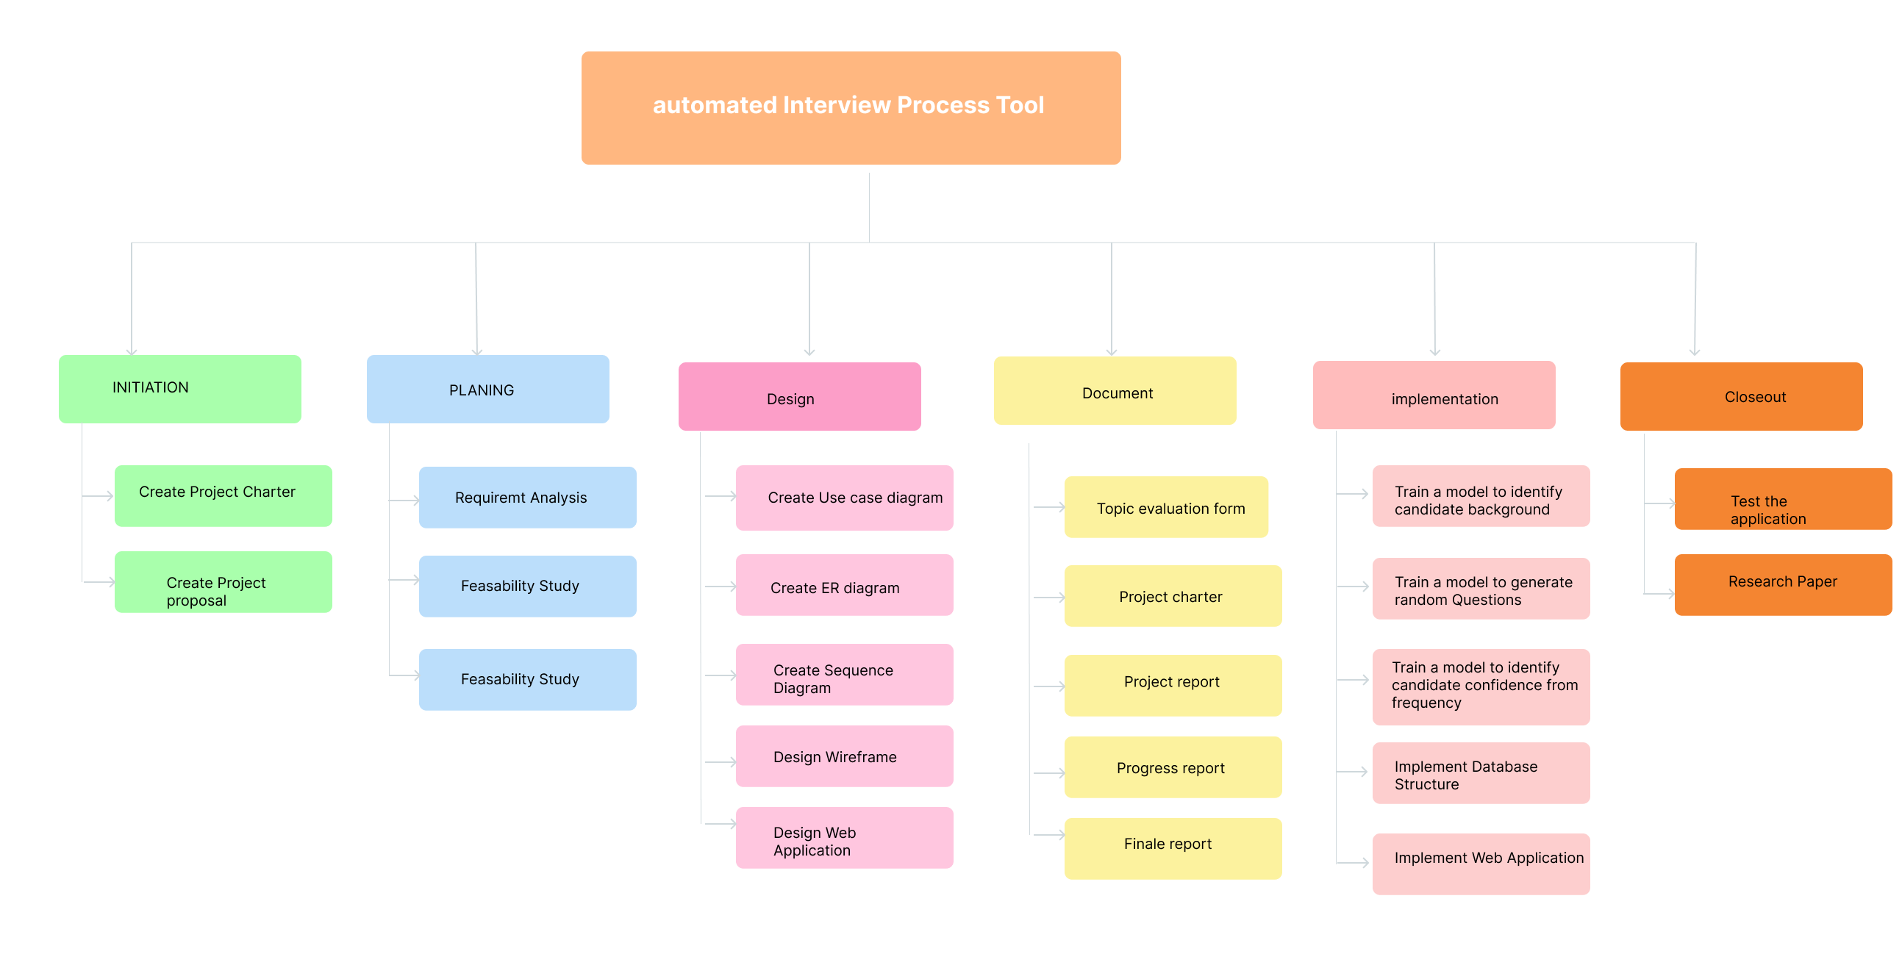
Workload Distribution

Slide 10

Road Map
Testing and Refinement
Conducting initial testing
Collecting test data and refining models.
Debugging and improving backend and frontend workflows
Enhancement and Commercialization
Ideation and Prototyping
Research problem identification
Building the foundational system
Tools, technologies, and methods decided
Frontend and backend setup
Usability testing with end-users
Feedback collection and final refinements
Core Development
Progress on building essential functionalities
Backend,DB, Microservice integration
Frontend implementation: basic dashboards

Slide 11
Individual Component Progress
60%
55%
55%
Funtion 1: VIDEO BASED MOCKUP EXAM
Completed Over 60%
Function 2: ASSESS STRESS IN GAMIFIED ENVIRONMENT
Completed Over 55%
65%
Function 3: ASSESS CODE COMPLEXITY AND MAINTAINABILITY
Completed Over 55%
Function 4 : ASSESS CONFIDENCE LEVEL FROM VOICE FREQUENCY
Completed Over 65%

Slide 12
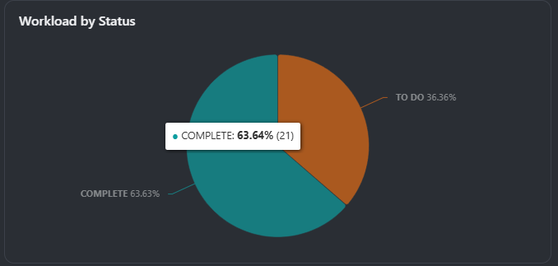
Project Progress
Over 63%
Overall Project Has Completed Over 63% without Any delays

Slide 13










01
Front End
02
Back End
Core
Technology Used
03
Data Base
04
Libraries
05
Version Control

Slide 14


IT21158186 | Pinsara A.R.D
Specialization : Information Technology
IT21158186 | Pinsara A.R.D | 24-25J-047

Slide 15

INTRODUCTION
"Introducing an innovative system that evaluates candidates primarily on their skills through a video-based mock-up test. Additionally, it assesses grooming, professionalism, and the working environment to provide a comprehensive candidate evaluation."
IT21158186 | Pinsara A.R.D | 24-25J-047

Slide 16

RESEARCH QUESTION
"How effective are video-based mockup tests in shortlisting candidates based on skill evaluation and assessing grooming, professionalism, and working environment? This research aims to address the reliance on subjective evaluations in current methods."
IT21158186 | Pinsara A.R.D | 24-25J-047

Slide 17
Research Area Concepts Used
NLP
Supervised Learning
Autonomous Decision Making
Computer Vision
NLP is used to analyze text-based responses from candidates in the mock-up test. It extracts critical insights, evaluates language skills, and ensures a detailed assessment of written answers.
A custom machine learning model is trained using labeled data to classify candidates based on grooming and environment. This ensures accurate and unbiased evaluations tailored to hiring requirements.
The system automates candidate evaluations by making independent decisions. This reduces human intervention, minimizes bias, and ensures consistent results in shortlisting.
Computer Vision techniques analyze snapshots from candidate videos, focusing on grooming and environment classification. This approach improves processing speed and evaluation accuracy.
IT21158186 | Pinsara A.R.D | 24-25J-047

Slide 18



SPECIFIC AND SUB OBJECTIVES
Specific Objective:
•To develop a system that uses video-based mock-up tests to objectively assess candidates' skills. The system will also evaluate grooming, professionalism, and working environment as supplementary criteria.
Sub Objectives:
To identify key skills from candidates' CVs and generate relevant mockup test questions.
To develop machine learning algorithms for assessing grooming, professionalism, and work environment.
To validate the effectiveness of this integrated evaluation system.
IT21158186 | Pinsara A.R.D | 24-25J-047

Slide 19

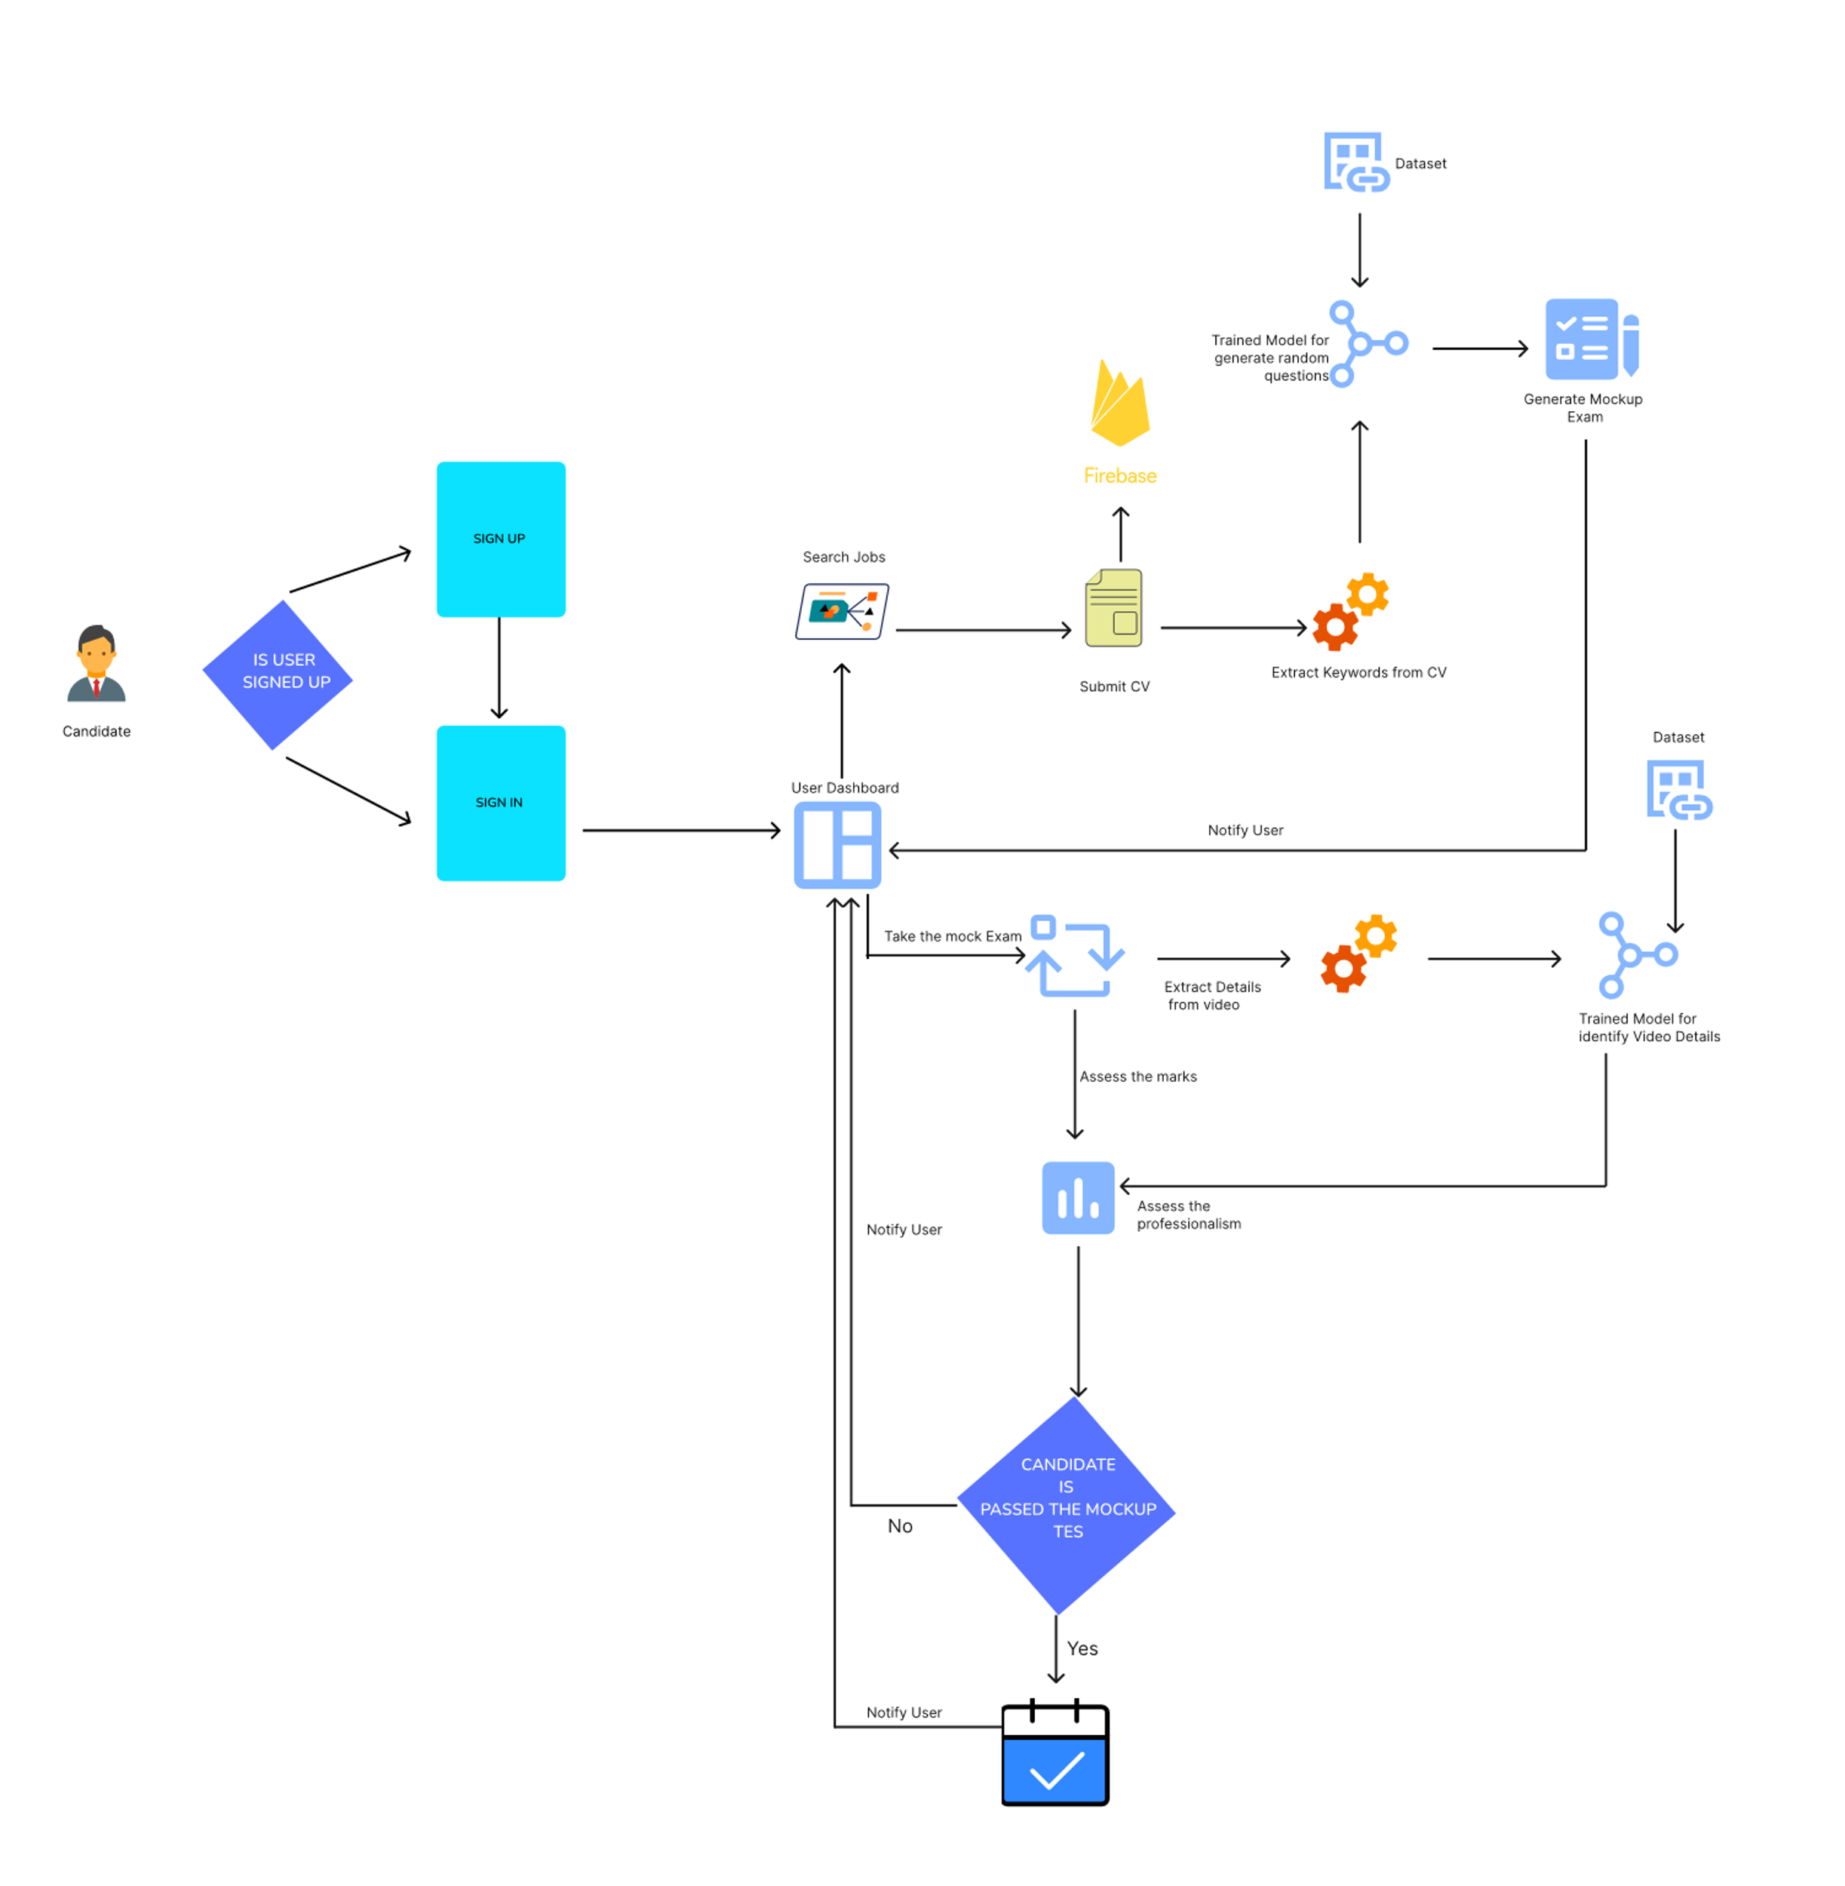
METHODOLOGY
IT21158186 | Pinsara A.R.D | 24-25J-047
System diagram

Slide 20
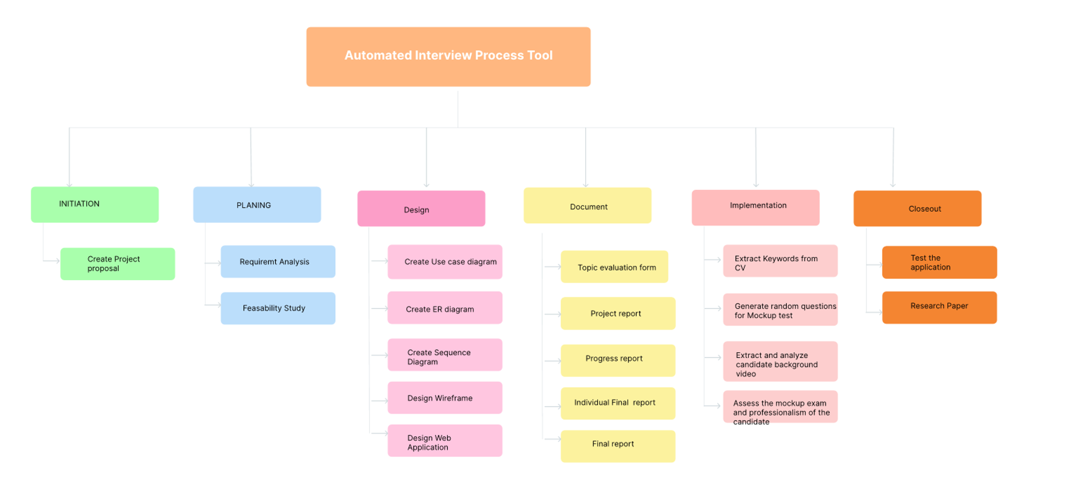
Workload Distribution
IT21158186 | Pinsara A.R.D | 24-25J-047

Slide 21









Timeline So far
Step 1
Step 2
Step 3
Step 4
Step 5
Step 6
Step 7
Step 8
Step 9
Initial Planing, Daraset Collecetion
Train the Models
Initial design concept
Initial Implementaion
Intergrate the MIcroservice
Model Intergration
Implementation With Frontend
Backend Intergration
Testing for the Phase 1
Week 1
Week 2
Week 3
Week 4
Week 5
Week 6
Week 7
Week 8
Week 9
Week 10
Week 11
Week 12
IT21158186 | Pinsara A.R.D | 24-25J-047
System diagram

Slide 22
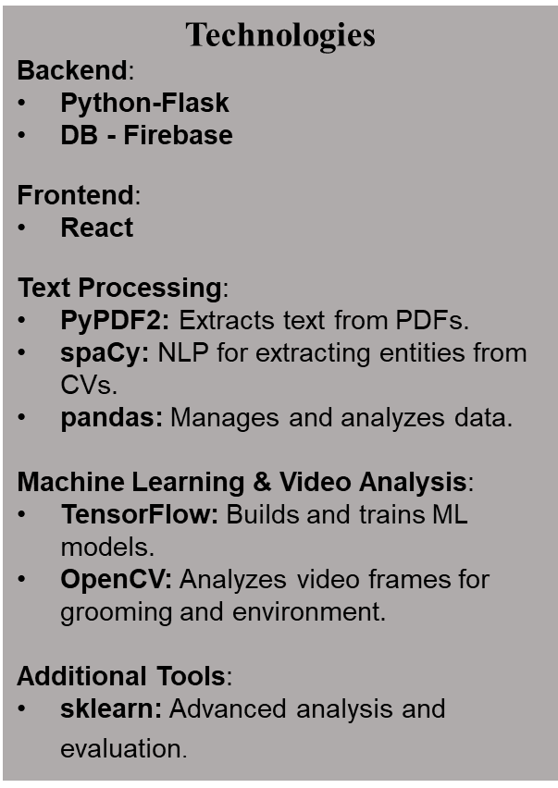
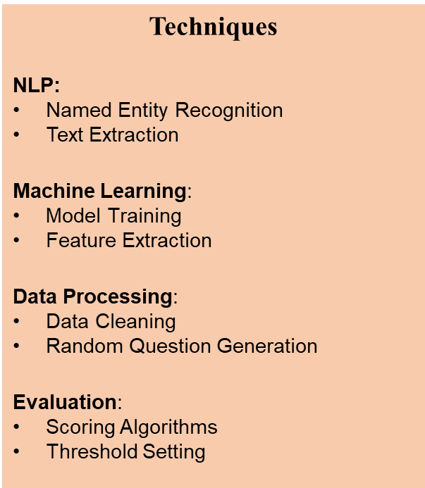
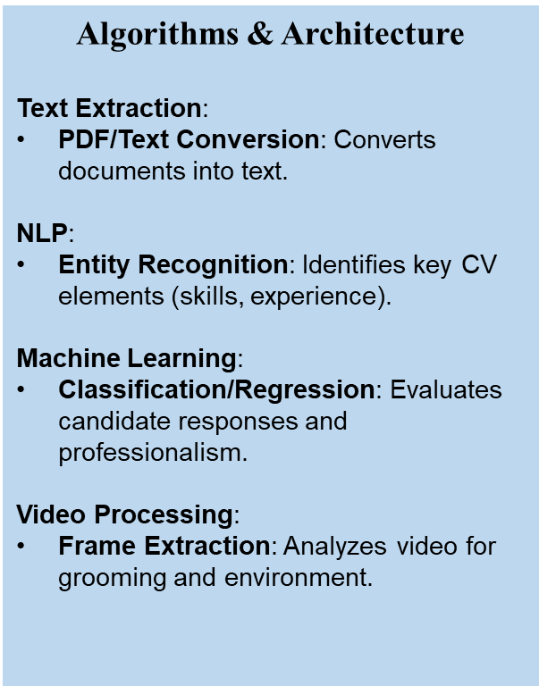
Technologies, Techniques, Algorithms
IT21158186 | Pinsara A.R.D | 24-25J-047

Slide 23
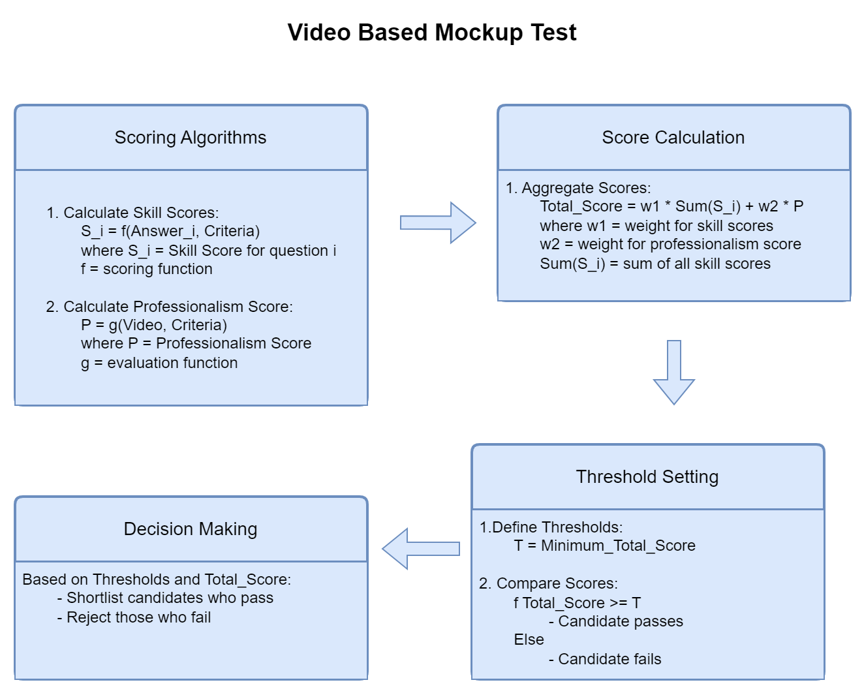


Candidate Evaluation Process
IT21158186 | Pinsara A.R.D | 24-25J-047

Slide 24


System, Personnel, and Software Specification Requirement
 |  | Server | Client Machines
Hardware | Processor | Multi-core CPU (e.g., Intel Xeon or AMD Ryzen) | Dual-core CPU
 | RAM | Minimum 16 GB | Minimum 4 GB
 | Storage | SSD with at least 500 GB of space | At least 10 GB free space
 | Network | High-speed internet connection | Stable internet connection
 | Camera |  | HD + quality web camera
Security | Data Encryption: | HTTPS for secure data transmission
 | Authentication: | Secure login mechanisms (e.g., JWT or OAuth)
 | Authorization | Role-based access control
IT21158186 | Pinsara A.R.D | 24-25J-047

Slide 25
Progress Highlights
Key Achievements:
Candidate Grooming & Environment Classification:
Custom model trained to analyze grooming and working environment of the candidate.
Classifies candidates into clean and formally dressed by classes through the model.
Node.js Backend & React Frontend:
Fully developed system with:
MCQ mock-up test interface.
Candidate Dashboard - Home
Evaluation results of this phase.
Employer module backend for custom questions.
Python Backend (microservice):
APIs for classification prediction handling
IT21158186 | Pinsara A.R.D | 24-25J-047

Slide 26

What's Next
Remaining tasks are minor and straightforward.
Confident in delivering a robust, efficient solution on time.
Revolutionizing hiring with automated, fair evaluations.
IT21158186 | Pinsara A.R.D | 24-25J-047

Slide 27

IT21170966 | Thennakoon T.M.I.C.
Specialization : Information Technology
IT21170966 | Thennakoon T.M.I.C.| 24-25J-047

Slide 28
INTRODUCTION
The fusion of emotional analysis with gamified assessments offers a novel approach to evaluating technical skills and problem-solving abilities.
By leveraging emotional cues and interactive, game-based tasks, this method provides a dynamic and engaging way to assess candidates' competencies beyond traditional testing.
IT21170966 | Thennakoon T.M.I.C.| 24-25J-047

Slide 29
Research Area Concepts Used
Facial Expression Analysis
Stress Detection
Gamified Skill Assessment
Autonomous Decision Making
Leveraged facial recognition models, such as OpenCV to analyze candidates' real-time facial expressions. These models categorize stress levels into low, moderate, and high, ensuring precise emotional insights.
Implemented machine learning models trained on stress detection datasets to categorize stress levels (low, moderate, and high) based on facial expressions. Threshold values are determined using model evaluation techniques for high accuracy.
Designed a gamified environment using Unity to evaluate candidates' technical skills (programming and database knowledge) through interactive problem-solving scenarios, minimizing traditional interview stress.
Developed a system integrating emotional and technical performance metrics. This automated evaluation helps recruiters make informed decisions about candidates' ability to handle industry-level stress without bias.
IT21170966 | Thennakoon T.M.I.C| 24-25J-047

Slide 30

RESEARCH GAP
Existing research often focuses on isolated aspects of emotional analysis
or gamified assessments.
Reference | Research Paper 1 | Research Paper 2 | Research Paper 3 | Proposed Function
Emotional Analysis | ✓ | X | ✓ | ✓
Gamified Assessments | X | ✓ | X | ✓
Integration of Emotional and Performance Data | X | X | ✓ | ✓
Evaluation of Technical Skills | X | ✓ | X | ✓
Evaluation of Problem-Solving Abilities | X | ✓ | X | ✓
IT21170966 | Thennakoon T.M.I.C.| 24-25J-047

Slide 31
RESEARCH QUESTION
How effective is the integration of emotional analysis and gamified assessments in evaluating technical skills and problem-solving abilities of candidates?
IT21170966 | Thennakoon T.M.I.C.| 24-25J-047

Slide 32

SPECIFIC AND SUB OBJECTIVES
Specific Objective:
To develop a system that evaluates technical skills and problem-solving abilities while using emotional analysis within a gamified environment.
Sub Objectives:
To enhance candidate's experience
To design gamified assessments that accurately evaluate technical skills.
Measure stress levels during problem-solving tasks
IT21170966 | Thennakoon T.M.I.C.| 24-25J-047

Slide 33
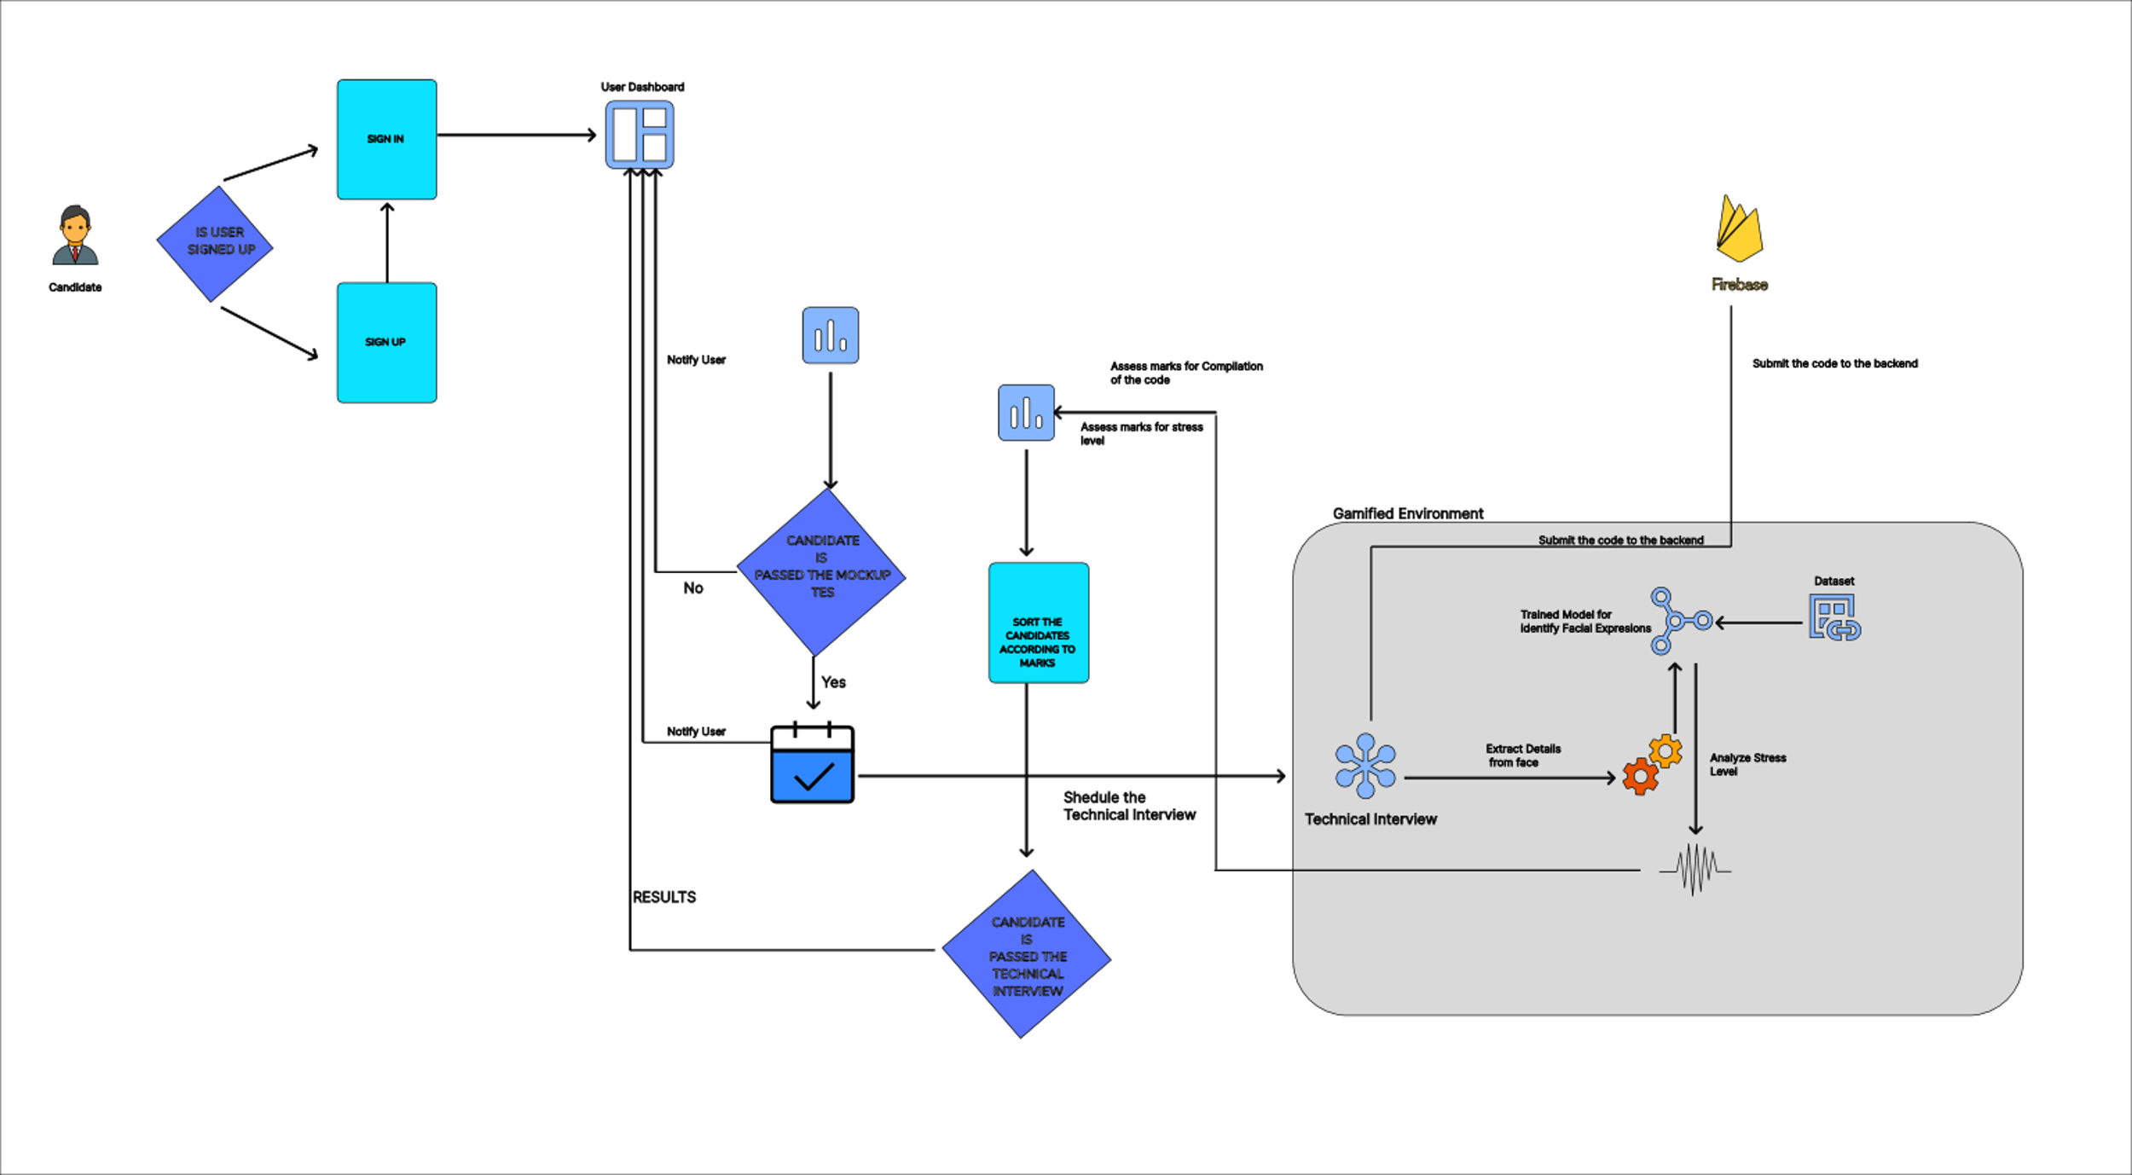
METHODOLOGY
IT21170966 | Thennakoon T.M.I.C.| 24-25J-047
System diagram

Slide 34
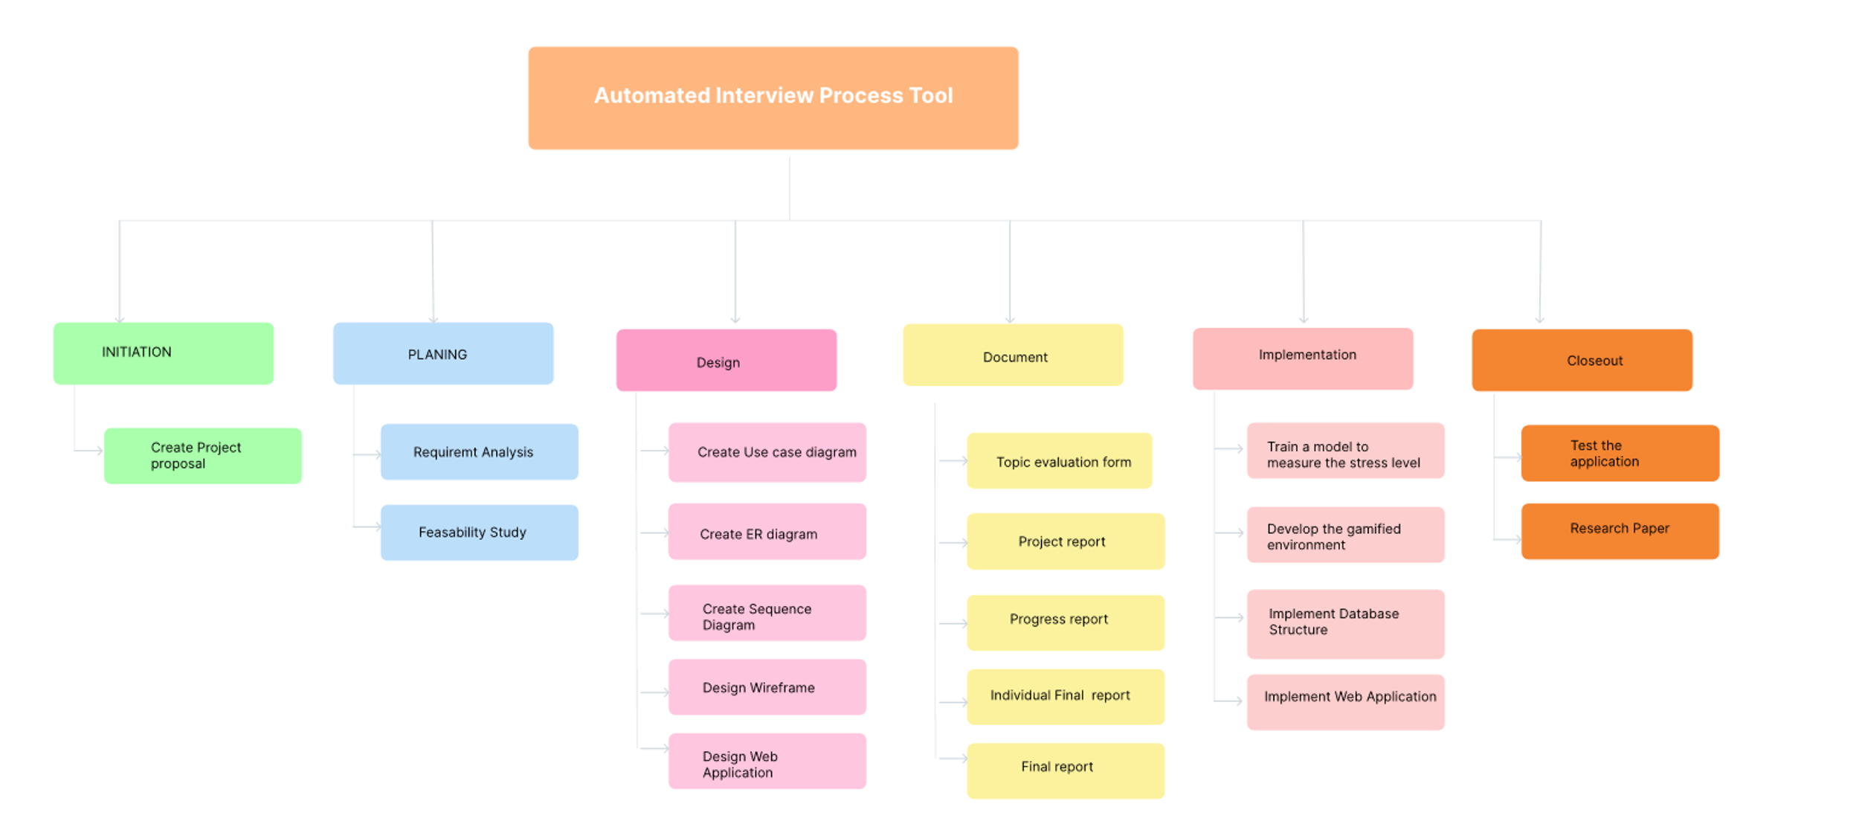
Workload Distribution
IT21170966 | Thennakoon T.M.I.C.| 24-25J-047

Slide 35
Timeline So far
Step 1
Step 2
Step 3
Step 4
Step 5
Step 6
Step 7
Step 8
Step 9
Initial Planing, Daraset Collecetion
Train the Models
Initial design concept
Initial Implementaion
Intergrate the MIcroservice
Model Intergration
Implementation With Frontend
Backend Intergration
Testing for the Phase 1
Week 1
Week 2
Week 3
Week 4
Week 5
Week 6
Week 7
Week 8
Week 9
Week 10
Week 11
Week 12
IT21170966 | Thennakoon T.M.I.C.| 24-25J-047
System diagram

Slide 36



System and Software Specification Requirement
Functional Requirements
Non-Functional Requirements
Real-time Facial Expression Analysis
Stress Level Measurement
Problem-Solving Skill Assessment
Integration with Gamified Environment
Data Storage and Management
Software Requirements
User-Friendly Interface
Real-Time Processing
High Accuracy and Reliability
Security and Privacy
Jupyter Notebook
VS Code
IT21170966 | Thennakoon T.M.I.C.| 24-25J-047
System diagram

Slide 37



Technologies, Techniques, Algorithms
Technologies
Techniques
Algorithms & Architecture
TypeScript
Python
Tensorflow
MongoDB
OpenCv
Transfer Learning
Data Augmentation
Convolutional Neural Network
(CNN)
IT21170966 | Thennakoon T.M.I.C.| 24-25J-047
System diagram

Slide 38
REFERENCES
[1] J. Smith, R. Brown, and L. Wang, "Real-Time Emotional Analysis in Online Learning Environments," IEEE Transactions on Affective Computing, vol. 12, no. 3, pp. 456-467, July-Sept. 2023, doi: 10.1109/TAFFC.2023.1234567.​
​
[2] A. Johnson and M. Lee, "Gamified Assessment Techniques for Evaluating Technical Skills in Remote Education," in Proc. 2022 IEEE Global Engineering Education Conference (EDUCON), Tunis, Tunisia, 2022, pp. 234-239, doi: 10.1109/EDUCON.2022.1234567.
[3] K. Patel, D. Nguyen, and P. Garcia, "Integrating Emotional Analysis with Performance Metrics in E-learning Systems," International Journal of Educational Technology in Higher Education, vol. 18, no. 1, pp. 78-89, Jan. 2024, doi: 10.1007/s12345-024-1234-x.
IT21170966 | Thennakoon T.M.I.C.| 24-25J-047

Slide 39
IT21167232 | P.M.R.S Anjalie
Specialization : Information Technology
IT21167232 | P.M.R.S Anjalie.| 24-25J-047

Slide 40
INTRODUCTION
Evaluating code complexity and maintainability is crucial in determining a candidate's coding proficiency in a technical role.
By developing an automated tool to assess these factors, we can streamline the interview process and ensure a higher quality of candidate selection.
IT21167232 | P.M.R.S.Anjalie | 24-25J-047

Slide 41
RESEARCH QUESTION
How can the complexity and maintainability of code be effectively assessed to shortlist candidates during a technical interview?
IT21167232 | P.M.R.S.Anjalie | 24-25J-047

Slide 42
Research Area Concepts Used
Code Complexity
Machine Learning
Supervised Learning
Autonomous Decision Making
Analyzing code using metrics like Cyclomatic Complexity (CC) to evaluate maintainability. Evaluating how easily software can be modified or maintained
Using machine learning to evaluate and shortlist candidates based on performance. Algorithms that suggest products or services to users
Complecity recognition models like Whisper were implemented to accurately transcribe code anwers inputs, enabling further analysis of value.
Integrates autonomous decision-making by using AI models to evaluate candidate code complexity generate.
IT21167232 | P.M.R.S Anjalie| 24-25J-047

Slide 43
RESEARCH GAP
Current research provides individual metrics for code complexity and maintainability but lacks using 3 metrics for assess the code.
Reference | Research Paper 1 | Research Paper 2 | Research Paper 3 | Proposed Function
Code Complexity Assessment | ✓ | ✓ | ✓ | ✓
Code Maintainability Assessment | ✓ | ✓ | X | ✓
Using CC, WCC ,CFS | X | X | X | ✓
Automated Tool for Interview Use | X | X | X | ✓
Validation Against Industry Standards | X | ✓ | X | ✓
IT21167232 | P.M.R.S.Anjalie | 24-25J-047

Slide 44
SPECIFIC AND SUB OBJECTIVES
Specific Objective:
To create a tool that assesses the complexity and maintainability of code submissions
during technical interviews.
Sub Objectives:
To identify key metrics for code complexity and maintainability.
To develop algorithms that analyze code submissions based on these metrics.
To validate the tool against industry-standard benchmarks and expert evaluations.
IT21167232 | P.M.R.S.Anjalie | 24-25J-047

Slide 45
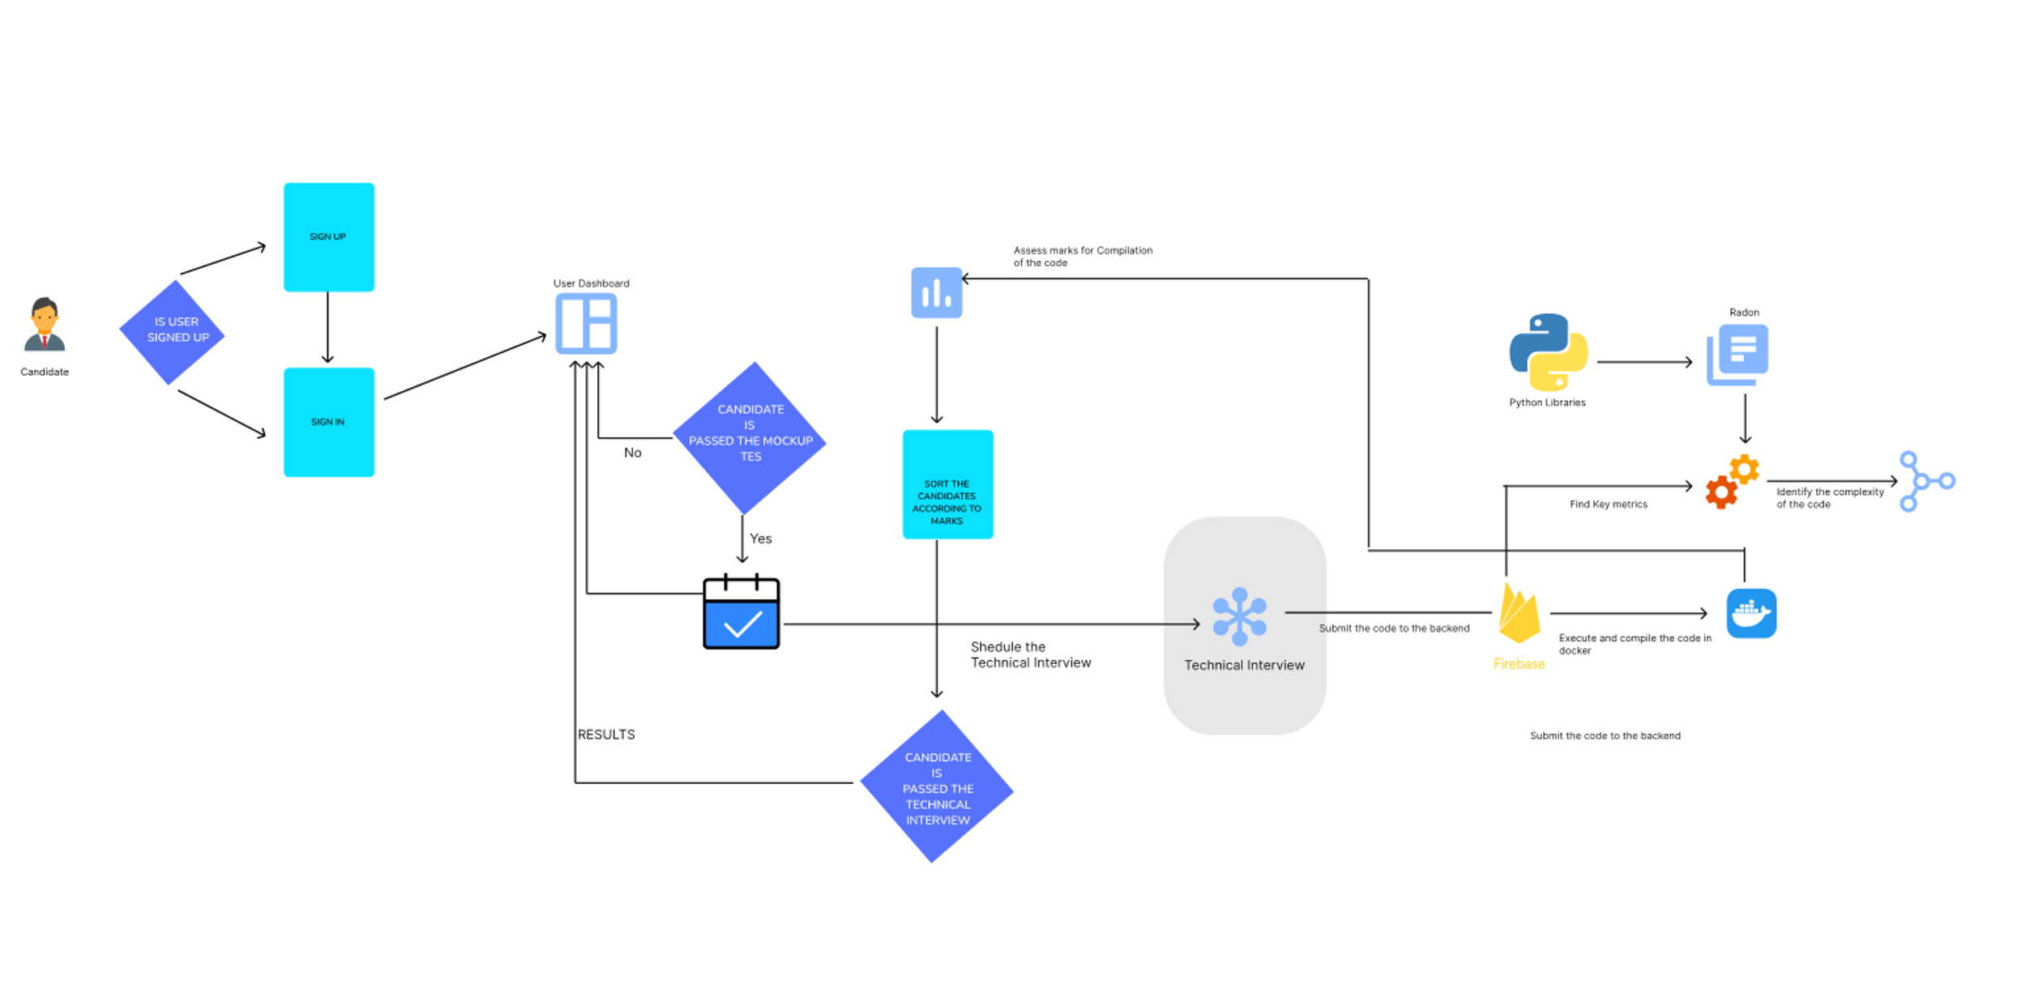
METHODOLOGY
IT21167232 | P.M.R.S.Anjalie | 24-25J-047
System diagram

Slide 46

Workload Distribution
IT21167232 | P.M.R.S.Anjalie | 24-25J-047

Slide 47
Timeline So far
Step 1
Step 2
Step 3
Step 4
Step 5
Step 6
Step 7
Step 8
Step 9
Initial Planing, Daraset Collecetion
Train the Models
Initial design concept
Initial Implementaion
Intergrate the MIcroservice
Model Intergration
Implementation With Frontend
Backend Intergration
Testing for the Phase 1
Week 1
Week 2
Week 3
Week 4
Week 5
Week 6
Week 7
Week 8
Week 9
Week 10
Week 11
Week 12
IT2167232 | P.M.R.S Anjalie| 24-25J-047
System diagram

Slide 48
System and Software Specification Requirement
Functional Requirements
Non-Functional Requirements
Complexity Metrics Calculation
Code Input
Multi Language support
Software Requirements
Performance
Accuracy
High Accuracy and Reliability
Security and Privacy
VS Code
Docker
IT21167232 | P.M.R.S.Anjalie | 24-25J-047
System diagram

Slide 49
Technologies, Techniques, Algorithms
Technologies
Techniques
Algorithms & Architecture
ReactJS
Python
MongoDB
Radon
Docker
Code Parsing
Cyclomatic Complexity
Cognitive Complexity
Weighted Cyclomatic Complexity
IT21167232 | P.M.R.S.Anjalie | 24-25J-047
System diagram

Slide 50
REFERENCES
U. Chhillar and S. Bhasin, "A New Weighted Composite Complexity Measure for Object-Oriented Systems," Department of Computer Science, Kurukshetra University, Kurukshetra,Haryana, India.
J. Shao and Y. Wang, "A New Measure of SoŌware Complexity Based on CogniƟve Weights,"Proceedings of the Third InternaƟonal Conference on CogniƟve InformaƟcs (ICCI'04), Victoria,BC, Canada, 2004, pp. 60-70.
IT21167232 | P.M.R.S.Anjalie | 24-25J-047

Slide 51
IT21319792 | Gunarathna N.W.P.B.M.
Specialization : Information Technology
IT21319792 | Gunarathna N.W.P.B.M| 24-25J-047

Slide 52

INTRODUCTION
The evaluation of non-verbal cues such as tone, pitch, and frequency provides deep insights into an individual's personality and confidence.
By analyzing these vocal features, we can derive valuable information that complements traditional interview assessments.
IT21319792 | Gunarathna N.W.P.B.M| 24-25J-047

Slide 53



STATISTICS
80%
candidates experience anxiety during interviews, which can significantly alter their vocal pitch and frequency
20%
Around
of interviewers may unintentionally let their biases influence their perception of a candidate’s vocal confidence
IT21319792 | Gunarathna N.W.P.B.M| 24-25J-047

Slide 54




RESEARCH QUESTION
How can tone, pitch, and frequency analysis accurately assess a candidate's personality and confidence during an interview?
How this would help the IT industry and how this will be a Innovative approach
IT21319792 | Gunarathna N.W.P.B.M| 24-25J-047

Slide 55
Research Area Concepts Used
NLP
Speech Recognition
Supervised Learning
Autonomous Decision Making
Utilized Natural Language Processing (NLP) techniques, such as BERT, to analyze text transcriptions of audio responses for contextual understanding and confidence evaluation.
Speech recognition models like Whisper were implemented to accurately transcribe audio inputs, enabling further analysis of tone, pitch, and sentiment
Speech recognition models like Whisper were implemented to accurately transcribe audio inputs, enabling further analysis of tone, pitch, and sentiment
Integrates autonomous decision-making by using AI models to evaluate candidate confidence levels and generate actionable insights without human intervention.
IT21319792 | Gunarathna N.W.P.B.M| 24-25J-047

Slide 56
RESEARCH GAP
Current interview processes heavily rely on subjective evaluations and traditional metrics, often overlooking the nuanced information embedded in vocal features.
Reference | Research Paper 1 | Research Paper 2 | Research Paper 3 | Proposed Function
Analysis of Tone | ✓ | X | ✓ | ✓
Analysis of Pitch | ✓ | X | X | ✓
Analysis of Frequency | X | ✓ | X | ✓
Correlation with Personality Traits | X | X | ✓ | ✓
Confidence Level Indicators | X | X | X | ✓
IT21319792 | Gunarathna N.W.P.B.M| 24-25J-047

Slide 57
SPECIFIC AND SUB OBJECTIVES
Specific Objective:
To develop an algorithm that evaluates personality and confidence using tone, pitch, and frequency during interviews.
Sub Objectives:
Identify key voice features that correlate with personality traits and confidence levels.
Collect and preprocess voice data for analysis.
Train and validate machine learning models on the voice data.
Integrate the voice analysis tool into the automated interview process.
IT21319792 | Gunarathna N.W.P.B.M| 24-25J-047

Slide 58
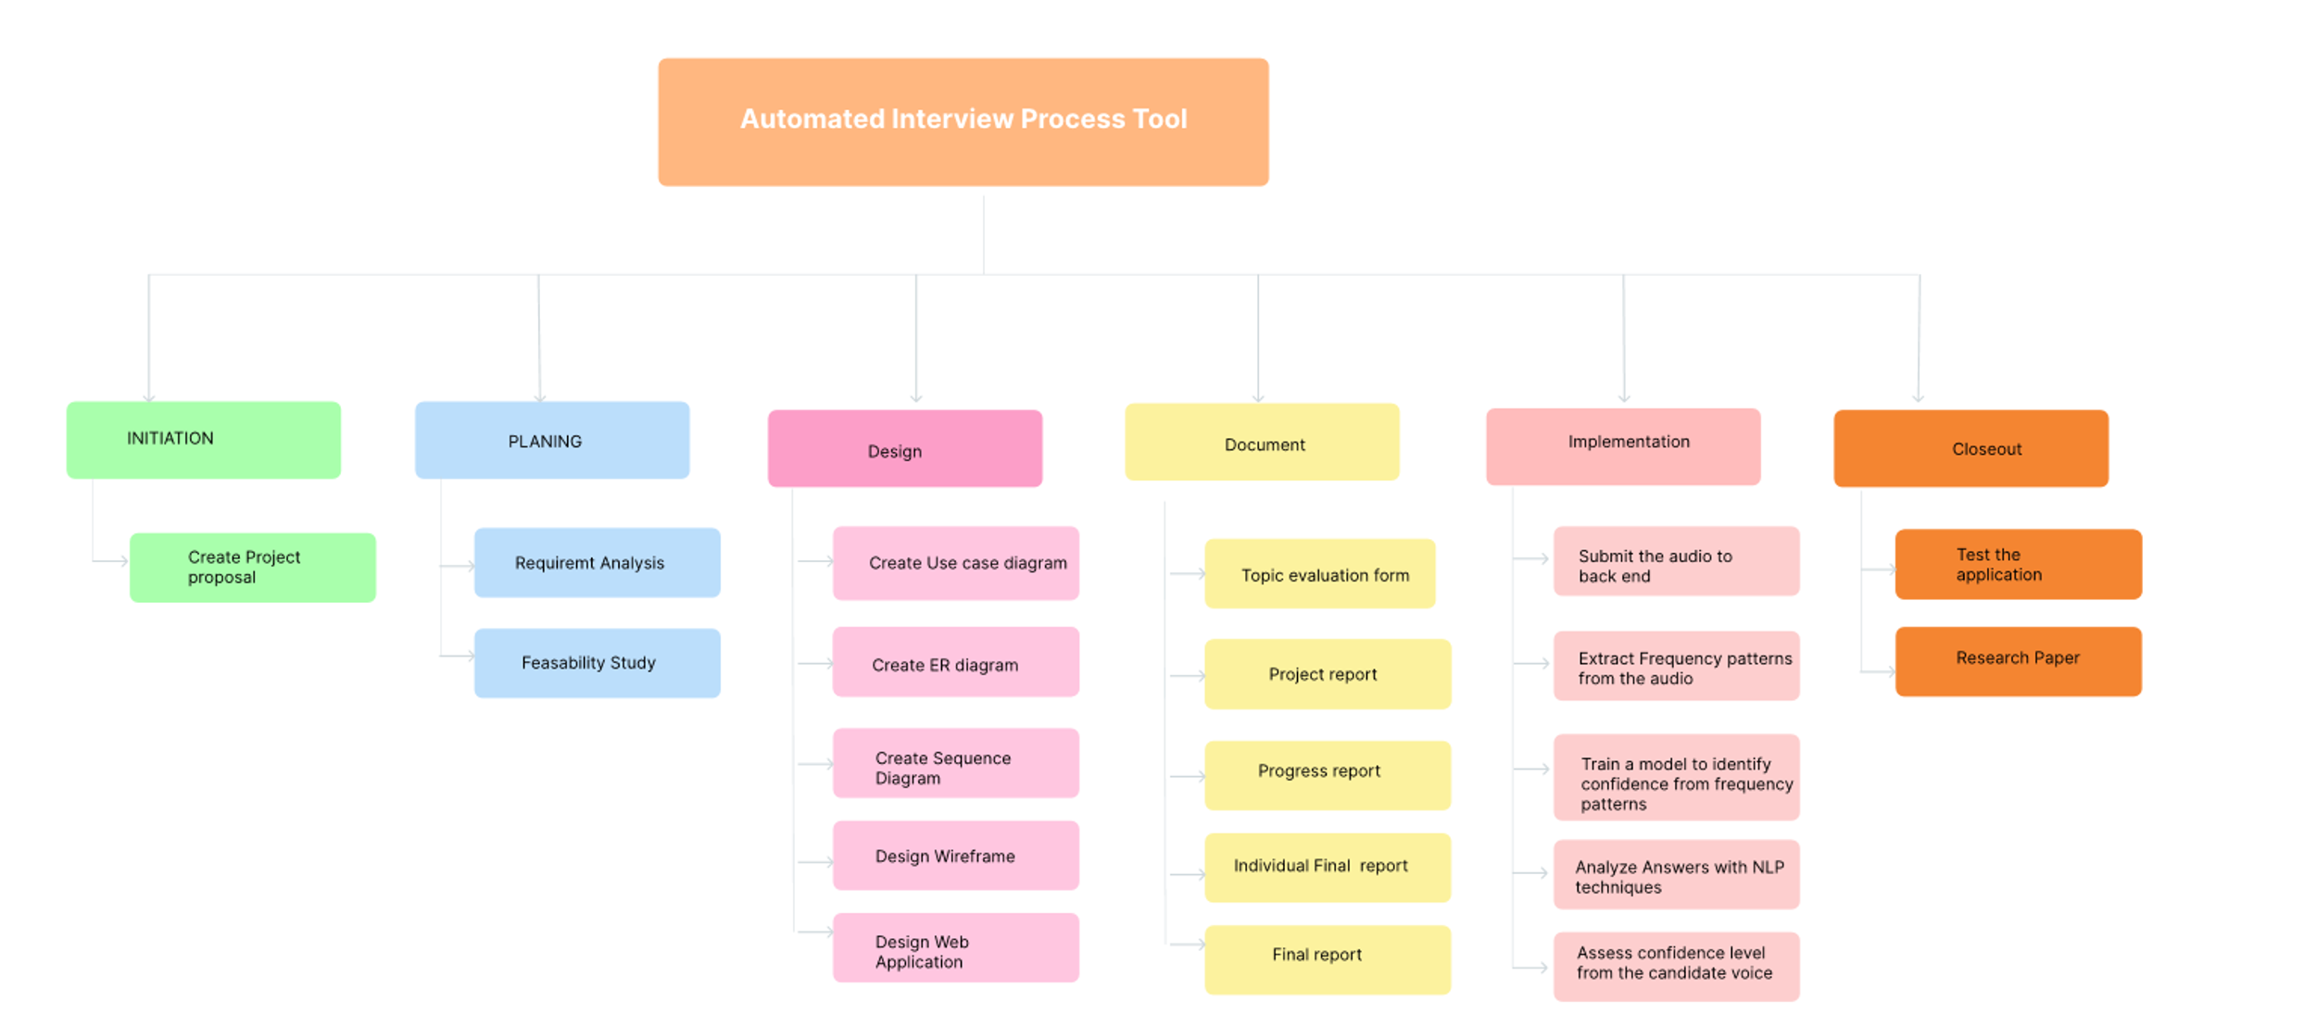
Workload Distribution
IT21319792 | Gunarathna N.W.P.B.M| 24-25J-047

Slide 59
Timeline So far
Step 1
Step 2
Step 3
Step 4
Step 5
Step 6
Step 7
Step 8
Step 9
Initial Planing, Daraset Collecetion
Train the Models
Initial design concept
Initial Implementaion
Intergrate the MIcroservice
Model Intergration
Implementation With Frontend
Backend Intergration
Testing for the Phase 1
Week 1
Week 2
Week 3
Week 4
Week 5
Week 6
Week 7
Week 8
Week 9
Week 10
Week 11
Week 12
IT21319792 | Gunarathna N.W.P.B.M| 24-25J-047
System diagram

Slide 60
System and Software Specification Requirement
Functional Requirements
Non-Functional Requirements
Audio Input
Frequency Analyze
Confidence Scoring
Feedback and reporting
Software Requirements
Performance
Accuracy
High Accuracy and Reliability
Security and Privacy
VS Code
Jupitor Notebook
IT21319792 | Gunarathna N.W.P.B.M| 24-25J-047
System diagram

Slide 61
Technologies, Techniques, Algorithms
Technologies
Techniques
Algorithms & Architecture
ReactJS
Python
NodeJS
MongoDB
Librosa
Docker
Librosa
PyDub
TensorFlow
Whisper
BERT
Supervised Model Training
Signal Processing
Feature Extraction
Fast Fourier Transform (FFT)
MFCC Extraction
Regression Models
IT21319792 | Gunarathna N.W.P.B.M| 24-25J-047
System diagram

Slide 62
REFERENCES
S. P. Dubagunta and M. Magimai.-Doss, "Segment-level Training of ANNs Based on Acoustic Confidence Measures for Hybrid HMM/ANN Speech Recognition," ICASSP 2019 - 2019 IEEE International Conference on Acoustics, Speech and Signal Processing (ICASSP), Brighton, UK, 2019, pp. 6435-6439, doi: 10.1109/ICASSP.2019.8683513
D. Yu, J. Li, and L. Deng, "Calibration of Confidence Measures in Speech Recognition," IEEE Transactions on Audio, Speech, and Language Processing, vol. 19, no. 8, pp. 2461-2473, Nov. 2011, doi: 10.1109/TASL.2011.2141988.
B. Ziółko, T. Jadczyk, D. Skurzok, and M. Ziółko, "Confidence measure by substring comparison for automatic speech recognition," 2012 International Conference on Audio, Language and Image Processing, Shanghai, China, 2012, pp. 314-318, doi: 10.1109/ICALIP.2012.6376632.
IT21319792 | Gunarathna N.W.P.B.M| 24-25J-047

Slide 63
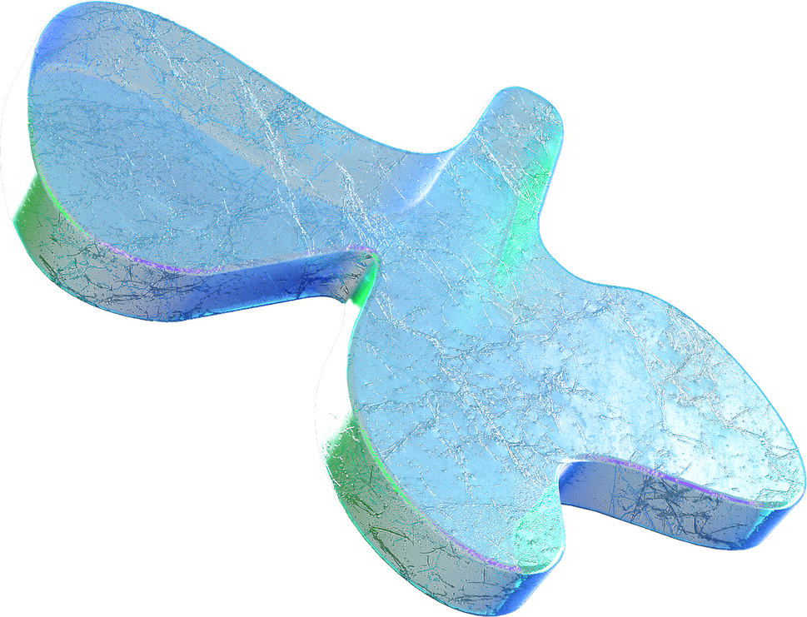
Do you have
any questions?

